Slide 1
Attendance Management System
Optimi College

Slide 2
Introduction
Back End
Front End
Stored procedures
Framework: Dapper
C#
CSS
HTML5

Slide 3
SWOT Analysis
Strength - Fingerprint and card system
Weaknesses - No logs of who is going out
Opportunities – Reforms the current system
Threats - More than one person can walk in with only one sign-in/log-in

Slide 4
Challenges
POPI Act (Protection of Personal Information Act
Removed First and Last names

Slide 5
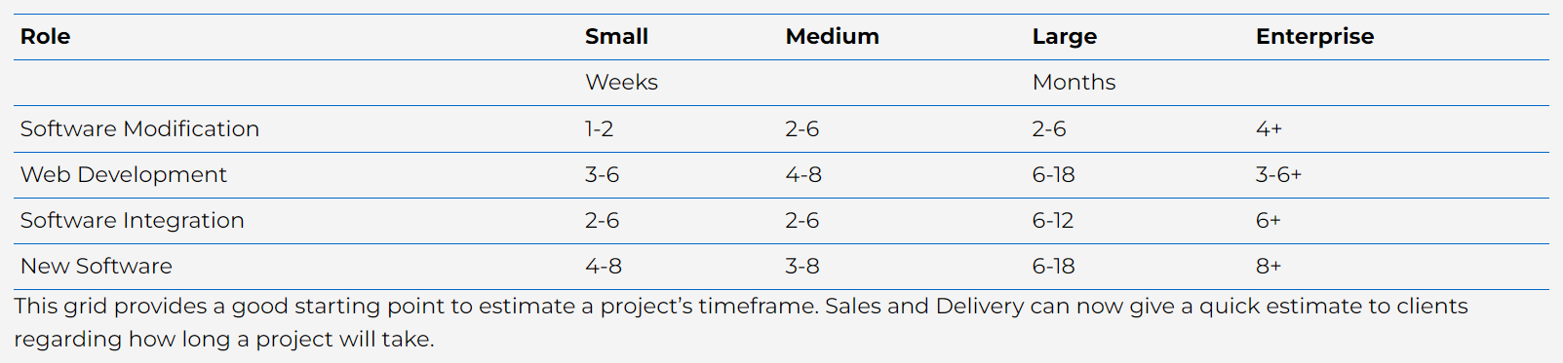
Budget Cont
Software Integration (small)
R28 000 – R75 000

Slide 6
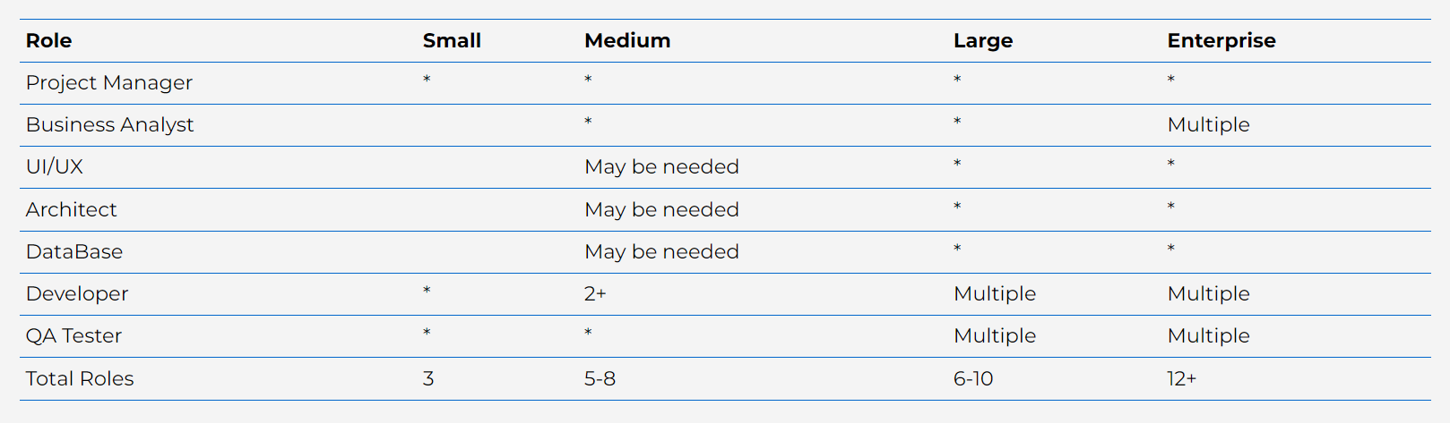
Budget Cont
Finished in 4 Weeks

Slide 7
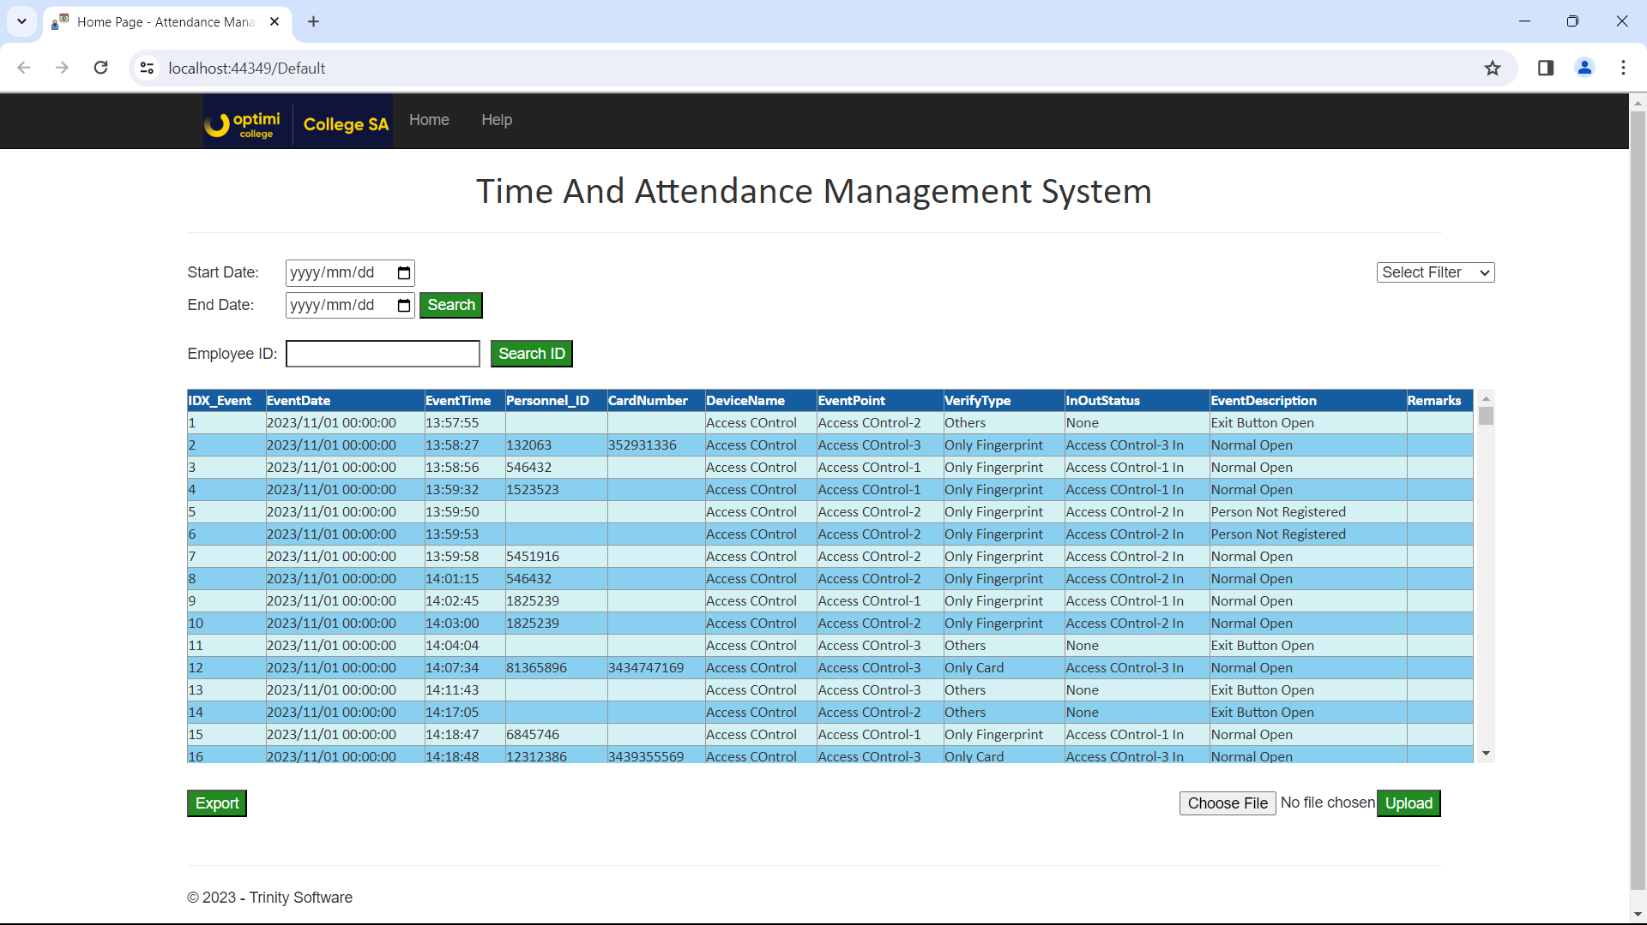

Slide 8
In Conclusion
User Acceptance Testing
Reliable and Consistent data retrieval and exporting.

Slide 9
Thank You
From the Software Trinity Group (pty)LTD

